Slide 1
Concurrency — Exercise 8
Thread Safety and Sharing

Slide 2
Problem 1
Sketch the objects that are created by the following program and how they reference each other. Which objects are stack confined and which ones are not?

Slide 3
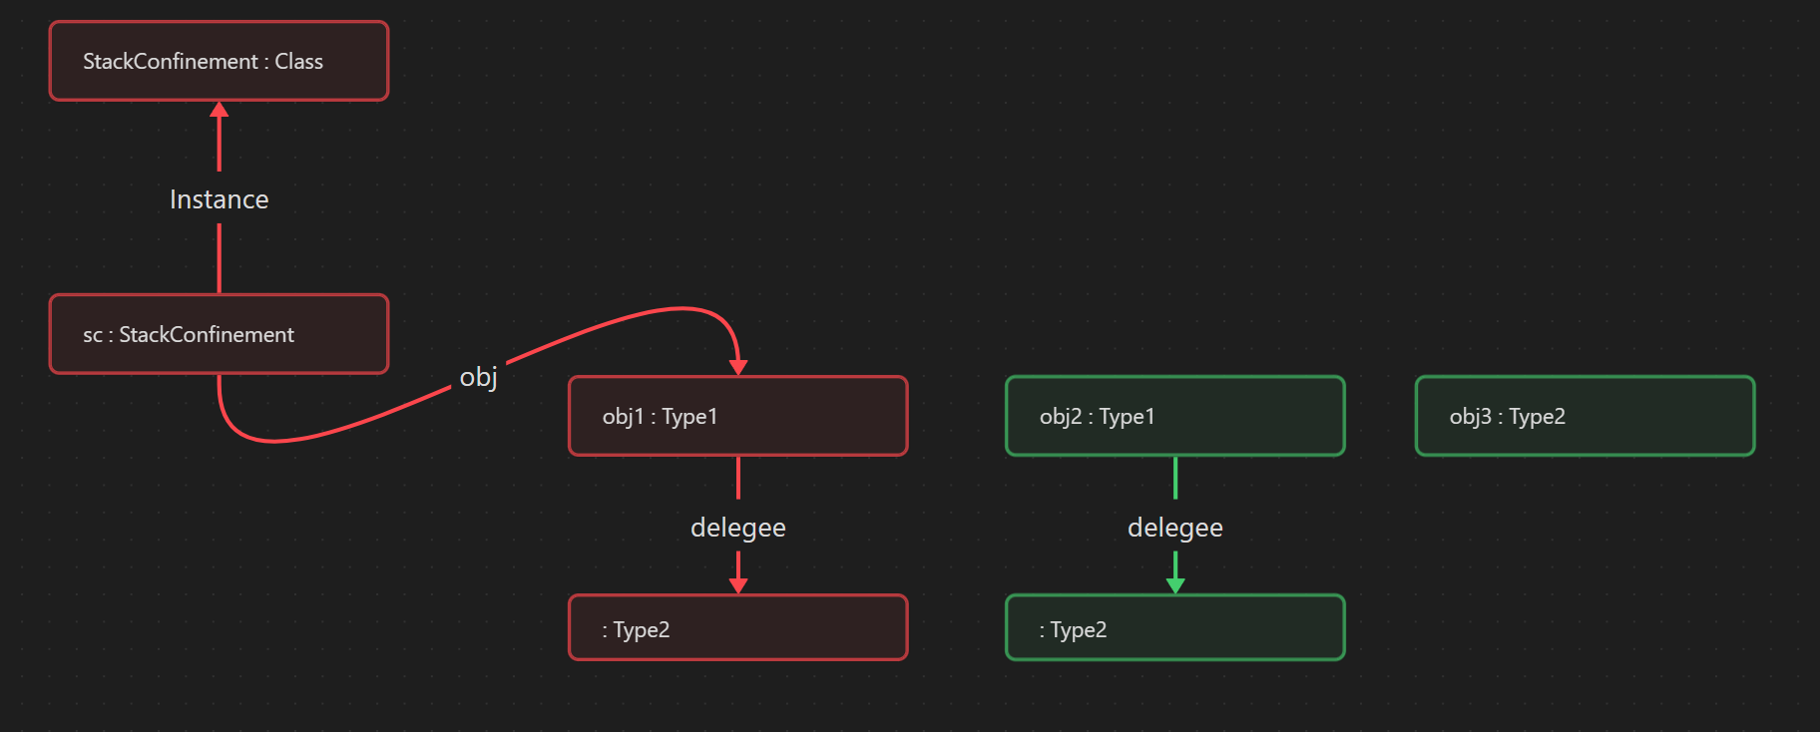
Notes:
sc wird in f() seinem eigenen static field(instance) zugewiesen (nicht StacConfined)
- obj gehört zu sc und sc ist nicht mehr stacConfined (nicht StacConfined)
- obj1 wird in setRef obj zugewiesen (nicht StacConfined)

Slide 4
Problem 2
Rewrite the following class ToBeImmutable to make it immutable with minimal changes. Do not change the classes XXX and YYY. Shortly explain each of your changes

Slide 5
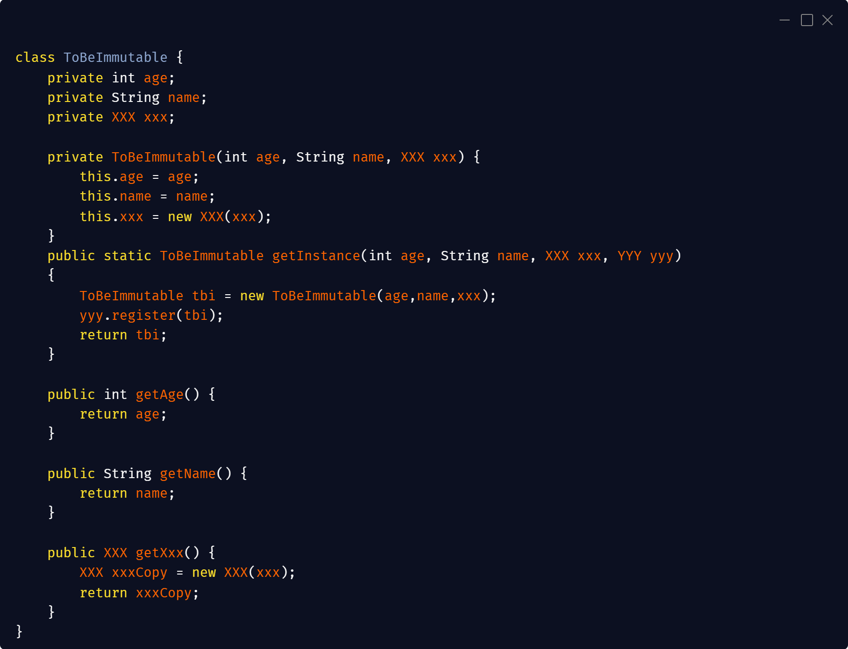

Slide 6
Problem 3
What is the potential concurrency problem with the following code. How can it be solved?

Slide 7
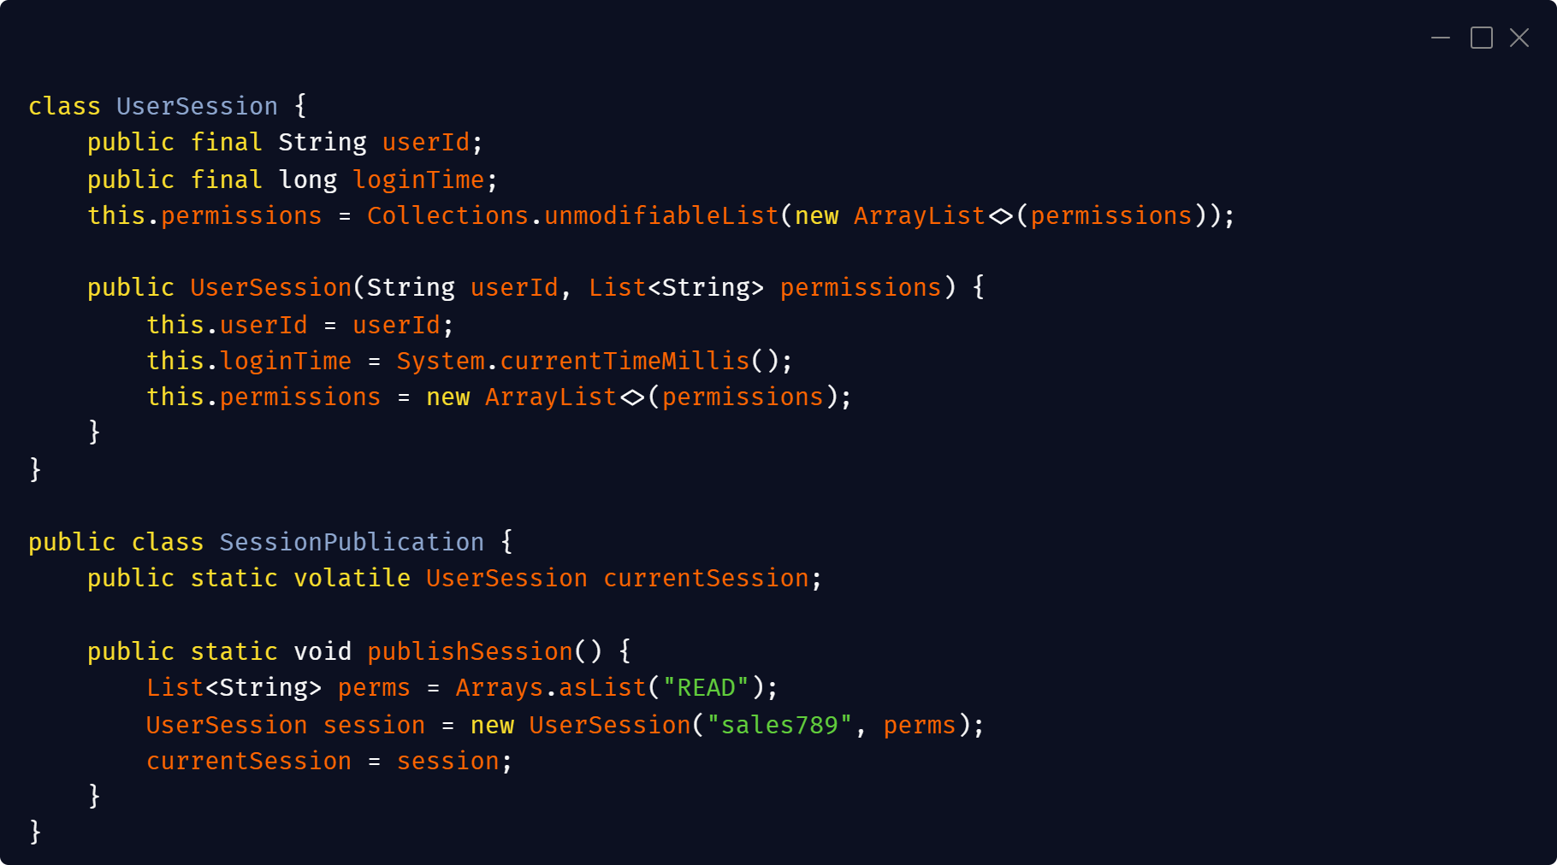
Notes:
nicht Atomares lesen von currentSession
Die Referenz auf permissions ist final nicht die einzelnen Elemente

